Slide 1
Running the Century Model Century “Nuts and Bolts” Version 4.7
Melannie D. Hartman
November 12, 2015

Slide 2
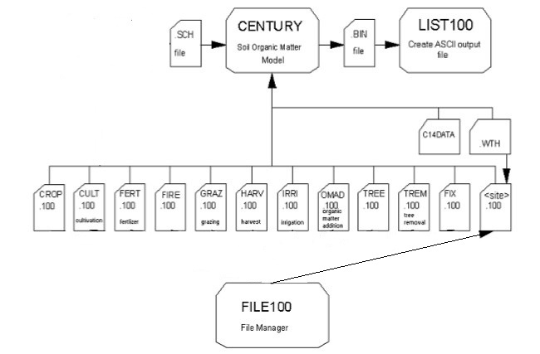
*.dat

Slide 3
Required input files for Century 4.7
Schedule File (.sch) – Directs the Century simulation. Links scheduled events to the parameter files.
Specifies weather files (.wth) to read
Specific site-specific parameter file: <site>.100
Specifies type of vegetation to grow (crop.100, tree.100)
Specifies management and disturbances
Tillage: CULT event (cult.100)
Fertilization: FERT event (fert.100)
Organic matter and compost additions: OMAD event (omad.100)
Irrigation: IRRI event (irri.100)
Grazing: GRAZ event (graz.100)
Fire: FIRE or TREM event (fire.100, trem.100)
Crop Harvest: HARV event (harv.100)
Wood removal: TREM event (trem.100)
fix.100 parameter file

Slide 4
Optional input files for Century 4.7
The *.dat files allow users to dynamically change model inputs during the simulation period.
nscale.dat - The optional multipliers on N inputs contained in this file can be used to scale the amount of fertilizer added through FERT events, the amount of atmospheric N deposition, or both.
omadscale.dat - The optional multiplier on OMAD inputs contained in this file can be used to scale the amount of organic matter added through OMAD events.
phscale.dat - The optional multipliers that can be used to change pH.
tmaxscale.dat - The optional addends that can be used to scale maximum temperature values.
tminscale.dat - The optional addends that can be used to scale minimum temperature values.
precscale.dat - The optional multiplier that can be used to scale precipitation values.
All of these files are organized in 13 columns. Column 1 is the simulation year. Columns 2 - 13 contain the scalars.

Slide 5
DOS command prompt window
Locating the DOS command prompt
Accessories
Right click to set properties
Save to desktop or pin to taskbar
Properties (right click on top of window)
Mark/Paste (right click in middle of widow)
Navigate to working directory

Slide 6
A few DOS commands
cd - Change Directory, displays the name of or changes the current directory
dir - DIRectory listing, displays a list of files and subdirectories in a directory
Wildcards:
* → any arbitrary character string
? → any single character
copy - COPY target file to destination file, copies one or more files to another location
erase <filename> - deletes one or more files
del <filename> - deletes one or more files (same as erase)
help <command> - displays help information on that command

Slide 7
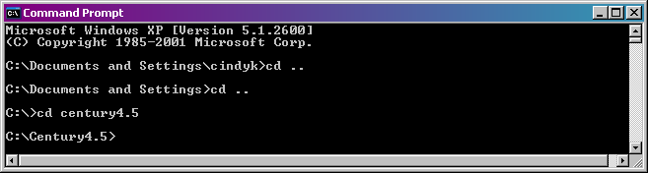
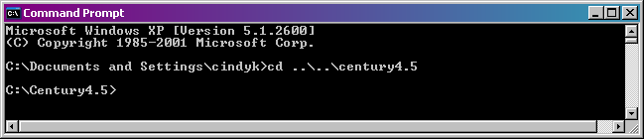
cd - Change Directory
cd .. → move up one level in the directory structure
cd century4.5 → move to a directory named century4.5
Using the \ character you can change more than one directory at a time

Slide 8
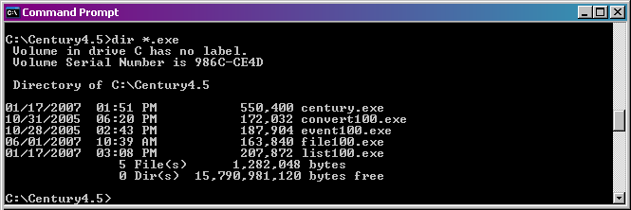
dir - DIRectory listing
dir and wildcards can be used together
dir *.exe → list all files in the current directory with .exe as the last 4 characters

Slide 9
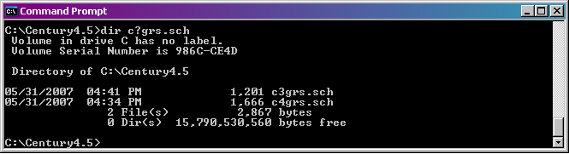
dir - DIRectory listing
? wildcard used with dir command
dir c?grs.sch → list all files in the current directory with c as the first character, grs.sch as the last 7 characters, with any one character in between

Slide 10
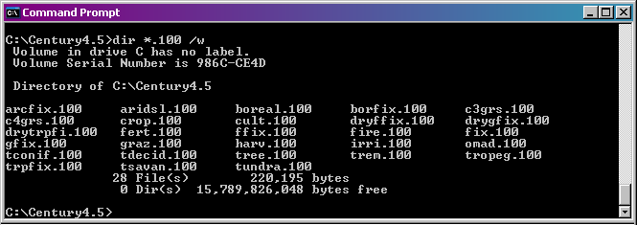
dir - DIRectory listing
switches can be used to change appearance of the display
/w switch → use wide list format
/p switch → pause after each screen full of information

Slide 11
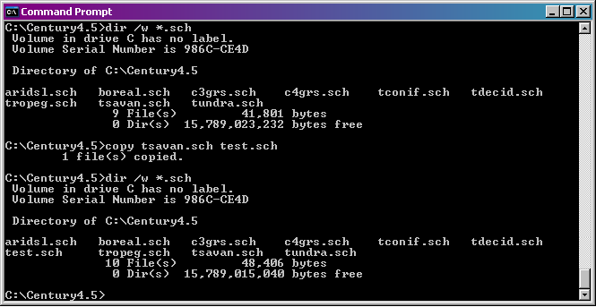
copy - COPY target file to destination file
copy <target file> <destination file>
For example, copy tsavan.sch to a file named test.sch

Slide 12
Let’s examine some Century Input Files in Century_Training\CSU_November_16-20_2015\Century_47_exercises\C3grass_Example\
Schedule file (c3grs.sch)
Century weather file (example.wth)
<site>.100 file (c3grs.100)
fix.100 file
*.100 files associated with schedule file events (graz.100, crop.100)

Slide 13
Example Century Command Lines
Century command line:
century_47 –s c3grs -n c3grs
The schedule file is named c3grs.sch and the binary output file created will be named c3grs.bin.
Running List100 in non-interactive mode:
list100_47 c3grs c3grs outvars.txt
List100_47.exe reads the c3grs.bin file and extracts the output for the variables listed in the outvars.txt file, creating the c3grs.lis file. The outvars.txt file is an ASCII text file that contains the list of output variables you want to extract from the binary file, one variable per line – you can name this file as you please.

Slide 14
Data requirements for running the Century model
Type of system (grass, crop, savanna, forest)
Average monthly precipitation (cm)
Average monthly minimum temperature (ºC)
Average monthly maximum temperatures (ºC)
Site latitude and longitude (decimal degrees)
Fraction sand, silt, and clay of the mineral soil, by layer (0.0-1.0)
Bulk density of the soil, by layer (g cm⁻³)
Rooting depth of the vegetation (cm)
Best estimate of annual wet and dry N deposition (g N m⁻² yr⁻¹)
Productivity of vegetation (g C m⁻² per year or growing season)
C:N ratio of above- and belowground vegetation (split into leaves, branches, large wood, fine roots, and coarse roots for trees)
Root to shoot ratio of vegetation (or % allocation of production to leaves, branches, large wood, fine roots, and coarse roots for trees)
Lignin content of vegetation (above- and belowground for grasses; split into leaves, branches, large wood, fine roots, and coarse roots for trees)

Slide 15
Additional data requirements for running the Century model
C in the soil organic matter in the top 20 cm of soil (g C m⁻²)
N in the soil organic matter in the top 20 cm of soil (g N m⁻²)
Do you want to include fire in your simulation of the system?
Is the system tilled?
Amount of fertilizer added (g N m⁻²)?
Do you want to simulate grazing?
What type of harvest is conducted?
How many cm of water are added through irrigation?
How much and what type of organic amendment is added (manure, fish meal, green manure, straw, compost)?
Is your system flooded at any point during the year?

Slide 16
Block scheduling notes
A block is a series of events which will repeat themselves, in sequence, until the ending time of the block is reached.
Example: one year repeating sequence, e.g. continuous corn, scheduled to occur from years 1981-1990
Year 1981, grow corn
Year 1982, grow corn
…
Year 1990, grow corn
4 Block # continuous corn, w/ fert
1990 Last year
1 Repeats # years
1981 Output starting year
1 Output month
1 Output interval
C Weather choice
1 5 CULT J
1 5 CROP C5
1 5 PLTM
1 5 FERT N9
1 5 CULT C
1 7 CULT C
1 10 HARV G
1 10 LAST
-999 -999 X

Slide 17
Block scheduling notes cont’d
Two year repeating sequence, e.g. winter wheat/fallow, scheduled to occur from years 1985-2000
Year 1985, grow wheat
Year 1986, fallow
Year 1987, grow wheat
Year 1988, fallow
…
Year 1999, grow wheat
Year 2000, fallow
5 Block # winter wheat/fallow
2000 Last year
2 Repeats # years
1985 Output starting year
1 Output month
1 Output interval
F Weather choice
weldCO.wth
1 5 CULT F
1 6 CULT F
1 7 CULT F
1 8 CULT G
1 9 CULT A
1 9 CROP W3
1 9 PLTM
1 9 FERT N7
2 7 HARV G
2 7 LAST

Slide 18
Block scheduling notes, cont’d
2 Block # Grass with 5-year burn
2003 Last year
5 Repeats # years
1971 Output starting year
1 Output month
1 Output interval
S Weather choice
1 1 CROP G4
1 1 FRST
1 8 FIRE MED
1 10 SENM
1 12 LAST
2 1 CROP G4
2 1 FRST
2 10 SENM
2 12 LAST
2 1 CROP G4
2 1 FRST
2 10 SENM
2 12 LAST
3 1 CROP G4
3 1 FRST
3 10 SENM
3 12 LAST
4 1 CROP G4
4 1 FRST
4 10 SENM
4 12 LAST
5 1 CROP G4
5 1 FRST
5 8 FIRE MED
5 10 SENM
5 12 LAST
-999 -999 X
Five year repeating sequence, e.g. tall grass prairie with burn every 5 years, scheduled to occur from years 1971-2003
Years 1971, 1972, 1973, 1974, grow grass
Year 1975, burn scheduled
Years 1976, 1977, 1978, 1979, grow grass
Year 1980, burn scheduled
...
Years 1996, 1997, 1998, 1999, grow grass
Year 2000, burn scheduled
Years 2001, 2002, 2003 , grow grass
Note that when a block ends prior to the end of the repeating sequence the events that were scheduled to occur in the years that fall outside the period in which the block was scheduled will not be simulated.

Slide 19
Block scheduling notes, cont’d
1 Block # Temperate Mixed
99 Last year
1 Repeats # years
1 Output starting year
12 Output month
12 Output interval
S Weather choice
1 1 TREE TMX
1 1 TFST
1 12 TLST
-999 -999 X
2 Block # Canopy/Ground Burn
100 Last year
1 Repeats # years
100 Output starting year
12 Output month
12 Output interval
S Weather choice
1 1 TREE TMX
1 1 TFST
1 8 FIRE GND
1 8 TREM BURN
1 12 TLST
-999 -999 X
3 Block # Temperate Mixed
199 Last year
1 Repeats # years
101 Output starting year
12 Output month
12 Output interval
S Weather choice
1 1 TREE TMX
1 1 TFST
1 12 TLST
-999 -999 X
100 year repeating sequence, e.g. forest with canopy and understory burn every 100 years.
This “could” be scheduled as a 100 year repeating block but it is easier to created two blocks:
Block 1, one year repeating sequence of tree growth, scheduled to occur over 99 years
Block 2, one year repeating sequence of forest fire, scheduled to occur over 1 year

Slide 20
Tricks of the Trade
Excel Templates
DOS batch files (.bat) - DOS commands that are "batch" processed
@REM run_c3grs.bat
@REM This batch file runs the example Century simulations on a Windows PC.
@REM Remove old output files
erase spinup.bin
erase c3grs.bin
erase c3grs.lis
@REM run the spinup simulation
erase spinup_log.txt
century_47 -s spinup –n spinup > spinup_log.txt
pause
@REM Run the example simulation
erase c3grs_log.txt
century_47 -s c3grs -n c3grs –e spinup > c3grs_log.txt
list100_47 c3grs c3grs outvars.txt

Slide 21
Output file notes
Note that the output time values in the *.bin files are computed by adding the fraction of the year (month/12) to the simulation year such that:
Year Month Calculation *.bin file
---- ---------- ----------- ----------
1900 Jan = 0.08 1900 + 0.08 1900.08
1900 Feb = 0.17 1900 + 0.17 1900.17
1900 Mar = 0.25 1900 + 0.25 1900.25
1900 Apr = 0.33 1900 + 0.33 1900.33
1900 May = 0.42 1900 + 0.42 1900.42
1900 Jun = 0.50 1900 + 0.50 1900.50
1900 Jul = 0.58 1900 + 0.58 1900.58
1900 Aug = 0.67 1900 + 0.67 1900.67
1900 Sep = 0.75 1900 + 0.75 1900.75
1900 Oct = 0.83 1900 + 0.83 1900.83
1900 Nov = 0.92 1900 + 0.92 1900.92
1900 Dec = 1.00 1900 + 1.00 1901.00 ←
1901 Jan = 0.08 1901 + 0.08 1901.08
etc.

Slide 22
Notes on Production output variables
The growing season production variables (*prd variables), agcprd, bgcprd, crtprd, eupprd(*), fbrprd, fcprd, frtprd, rlvprd, and rlwprd, are set equal to the value of their associated accumulator variable (*acc variable) when a LAST or TLST occurs, just before the *acc variables are reset to zero. The *prd values can be used to examine the amount of production that occurred over the previously completed growing season. The *prd variables will be set back to zero in January if no production has occurred over the previous 12 month period.

Slide 23
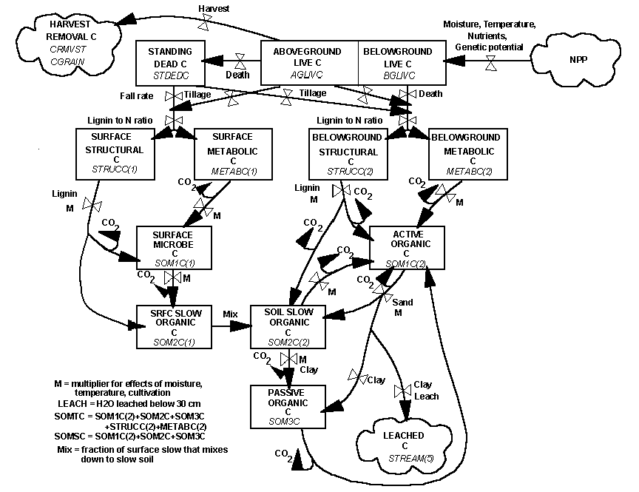
Flow diagram for the soil carbon submodel.

Slide 24
Gotcha’s
Incorrect units in weather file
Century weather file not in “a4, 6x, 12(7.2) format”
Weather statistics in <site>.100 file do not match the weather data file being used (check for discontinuity in tave, stemp, rain, and prcann output variables).
Too much/too little atmospheric N deposition (check wdfxma and wdfxaa output variables).
Cultivation event scheduled to occur prior to harvest event
Leaving out an event in a pair (FRST/LAST, PLTM/LAST, TFST/TLST) in the schedule file.
Interpreting results based on only end-of-year annual output when some variables (such as aglivc) are a minimum (check monthly output also).

Slide 25
Analyzing model output
Check NPP output variables for site
Crops/Grasses: agcacc, bgcacc, agcprd, bgcprd
Trees: rlvacc, fbracc, rlwacc, frtacc, crtacc, fcacc, rlvprd, fbrprd, rlwprd, frtprd, crtprd, fcprd
Reasons NPP may be too high or too low:
Need adjustment to PRDX parameter in crop.100 and/or tree.100.
The temperature function used in the growth equations may be parameterized incorrectly, i.e., trying to grow a C3 grass using a C4 grass temperature curve. Adjust the PPDF(*) parameters in the crop.100 and/or tree.100 file.
N deposition rates are too high or too low. Check wdfxma and wdfxaa output variables. Adjust EPNFA(*) parameters in the <site>.100 file.
Once the NPP seems reasonable for the site go on to check other output values.

